Slide 1
Take flight
SUBTITLE GOES HERE

Slide 2
Ideas/games
Prison Escape in low poly
2. Pick Pocket game
Paper airplane in office
Untitled goose game
I am Bread
The escapists
Plague INC
Thief simulator
Totally Accurate Battle Grounds

Slide 3
Idea
You play as a paper airplane, trying to disrupt a office work place. Glide around, complete challenges and find the Easter eggs scattered around the map, giving you upgrades such as a little fan, allowing for greater speeds and further glide distance, a steel tip which lets you break glass etc... Basic challenges offer basic rewards and the tricky challenges have a bigger reward. Disrupting the office is the main goal, so the challenges are based around it. Each challenge will be timed and graded so you can repeat challenges over and over. While in free roam, there is a point system that measures how much destruction you have caused. You could turn off the lights to knock cups off desks. Different style planes can be unlocked by getting certain scores or times. Hitting someone in the office will cause them to retaliate throw their own paper airplane and it will build up until the whole office is throwing them.

Slide 4
Product
Take Flight is a single player game that is open world and includes challenges within. The game will be on PC and has the possibility of being on consoles such as PlayStation and Nintendo Switch. The game will be in 1080p and include different settings to help lower powered systems run the game.

Slide 5
Elevator pitch
Take flight is for people who enjoy time based challenges and are looking for a unique game experience. Take Flight will be primarily based on PC will the option to move to console so everyone can enjoy. Take Flight is a challenging game that rewards the player for exploring the world. The unique and fun world of Take Flight keeps the player interested and the replay-ability is endless. The only game that has some similarity is an old game called playground on the Wii. Its an outdated game on a outdated platform so the market is completely open. Take Fight Makes the player cause mischief within an office and it’s completely family friendly. The game has no violence so young children and adults can play it.

Slide 6
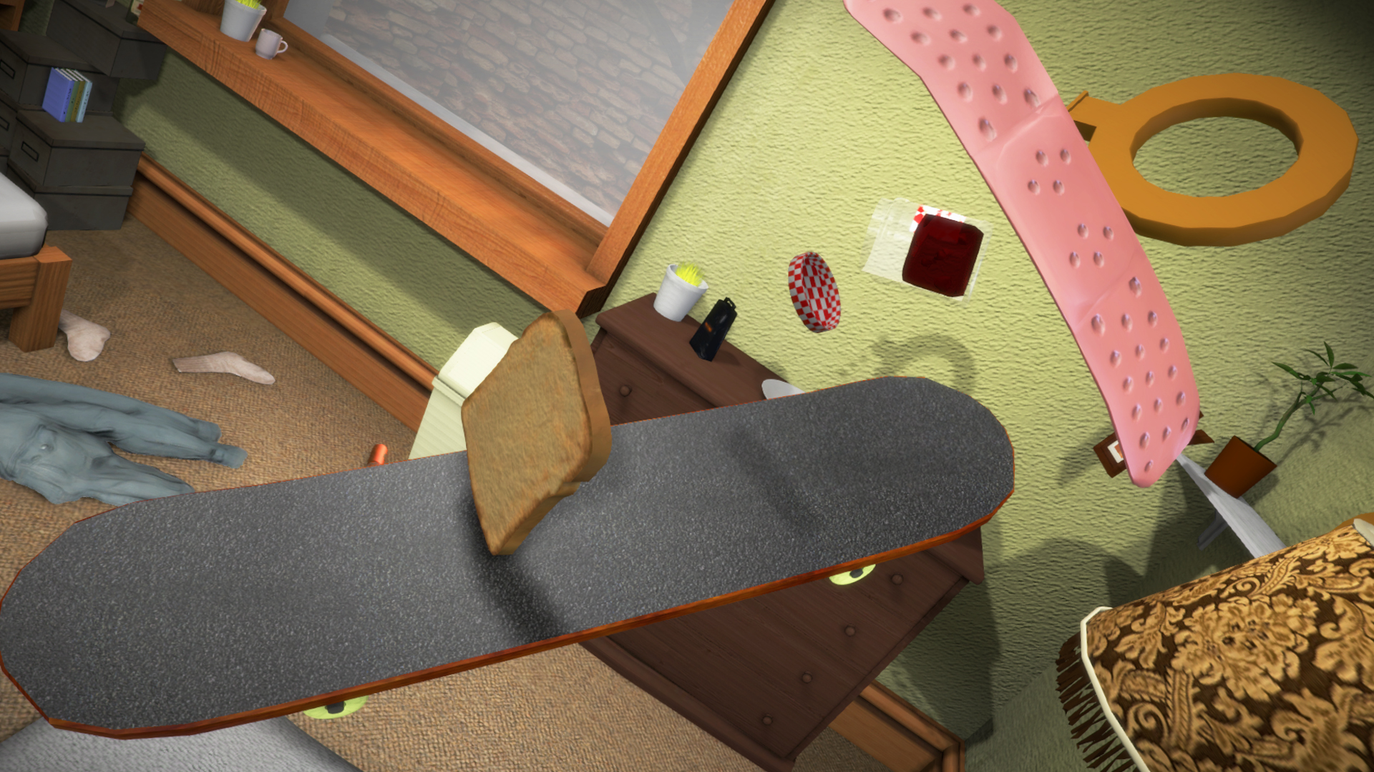
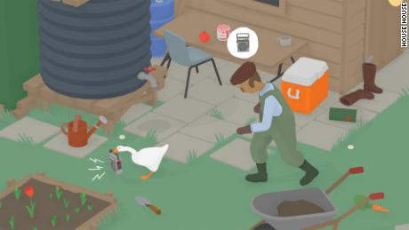
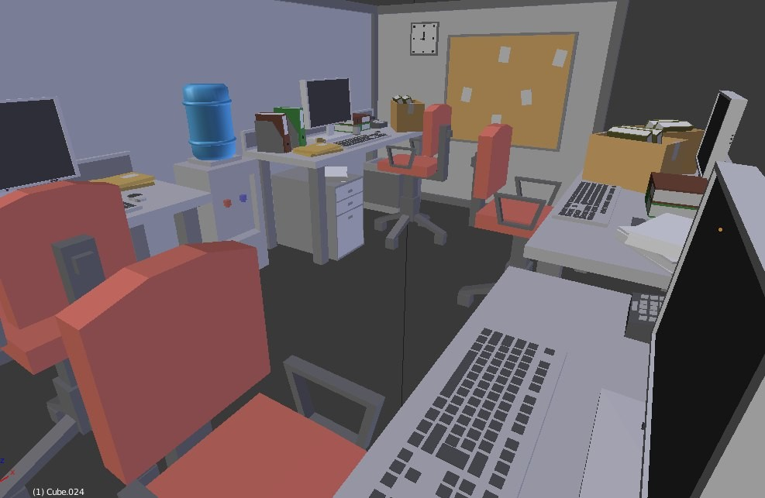
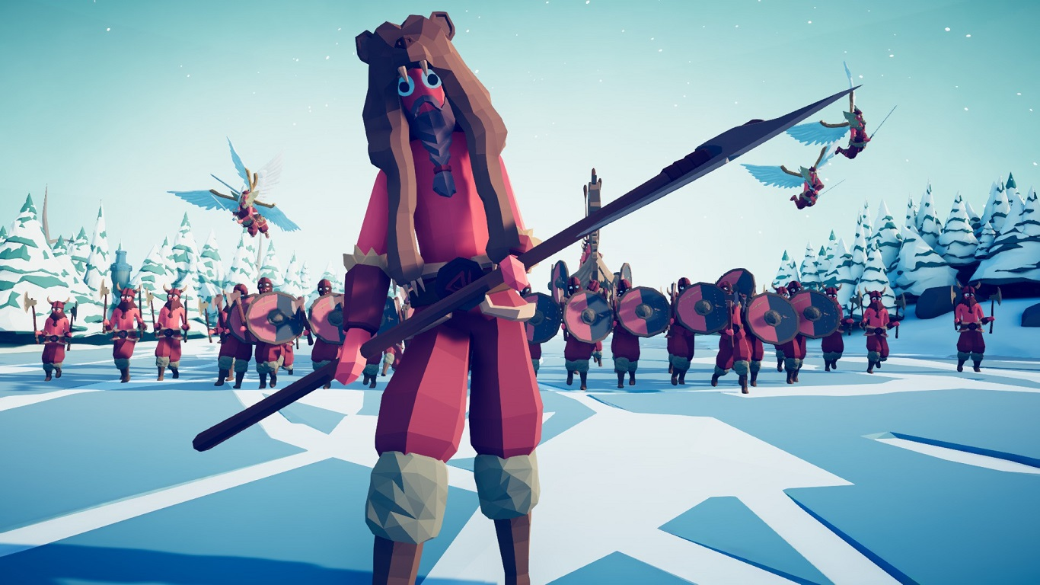
Research IMAGES

Slide 7
Target audience
Take Flight targets people under 15 who want to be able to play a casual or competitive game. For the younger kids, they can just free roam and explore the environment and the older kids can try and complete challenges in the fastest time. Families can also play the game and have competitions in the game.

Slide 8
Features/Content
Challenges (these can vary from flying through objects to destroying the office)
Free Roam
Upgrades to plane (propellers, tips(mental breaks glass, sponge bounces), shape of plane, stickers to customize plane).
Angering office workers to cause a paper plane fight
Easter eggs to unlock items/new challenges
One big environment with different sections (computer, kitchen etc..)
Items such as shredded paper bomb

Slide 9
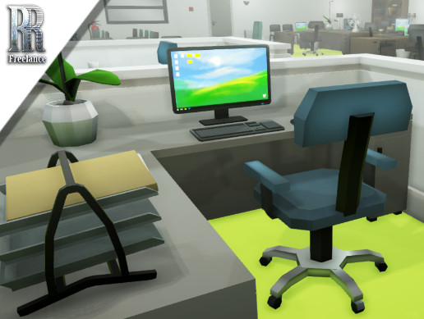
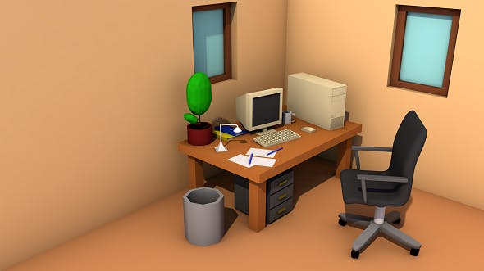
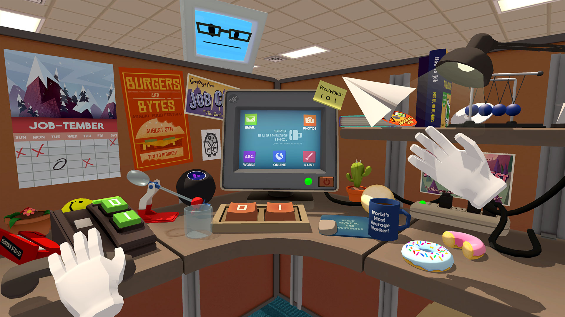

Style design
Low/Medium poly

Slide 10
Role breakdown
Programmer 1/5
3D Environment Artist 1/5
3D Animator 1/5
Model Designer 1/5
Audio 1/5

Slide 11
MVP Goals
Easy controls to control plane
Fully interactable environment
Timer with challenges(At least one of each challenge)
Upgradeable plane
Basic yet replay able experience
GUI with indicators
Effects that bring the world to life
Sound that makes the game more immersive

Slide 12
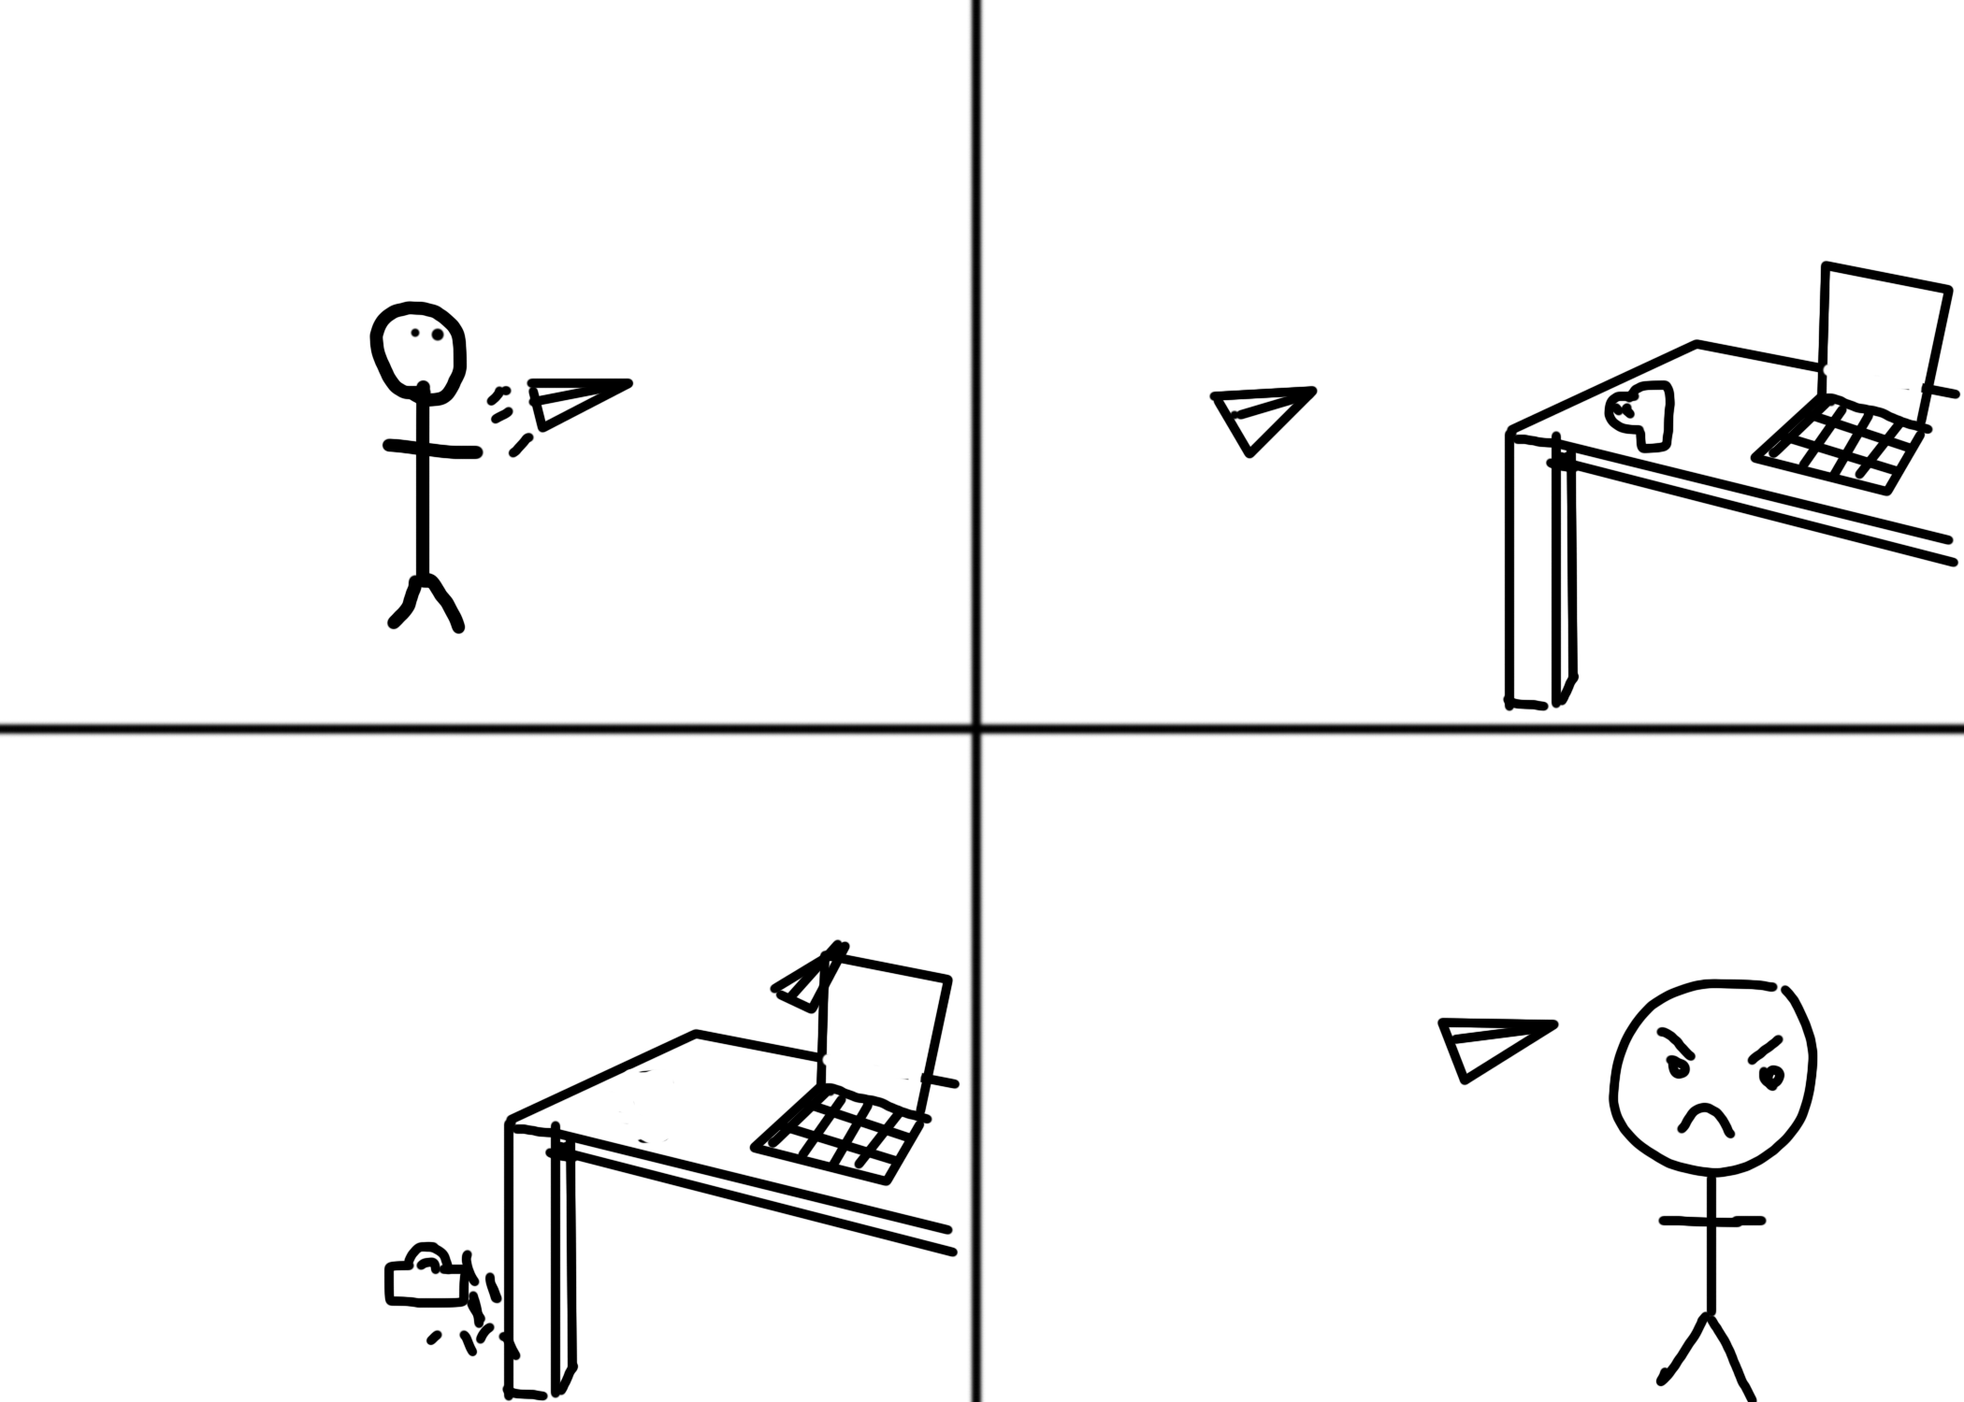
Playboard

